Slide 1

Minor Project
SR University

Slide 2
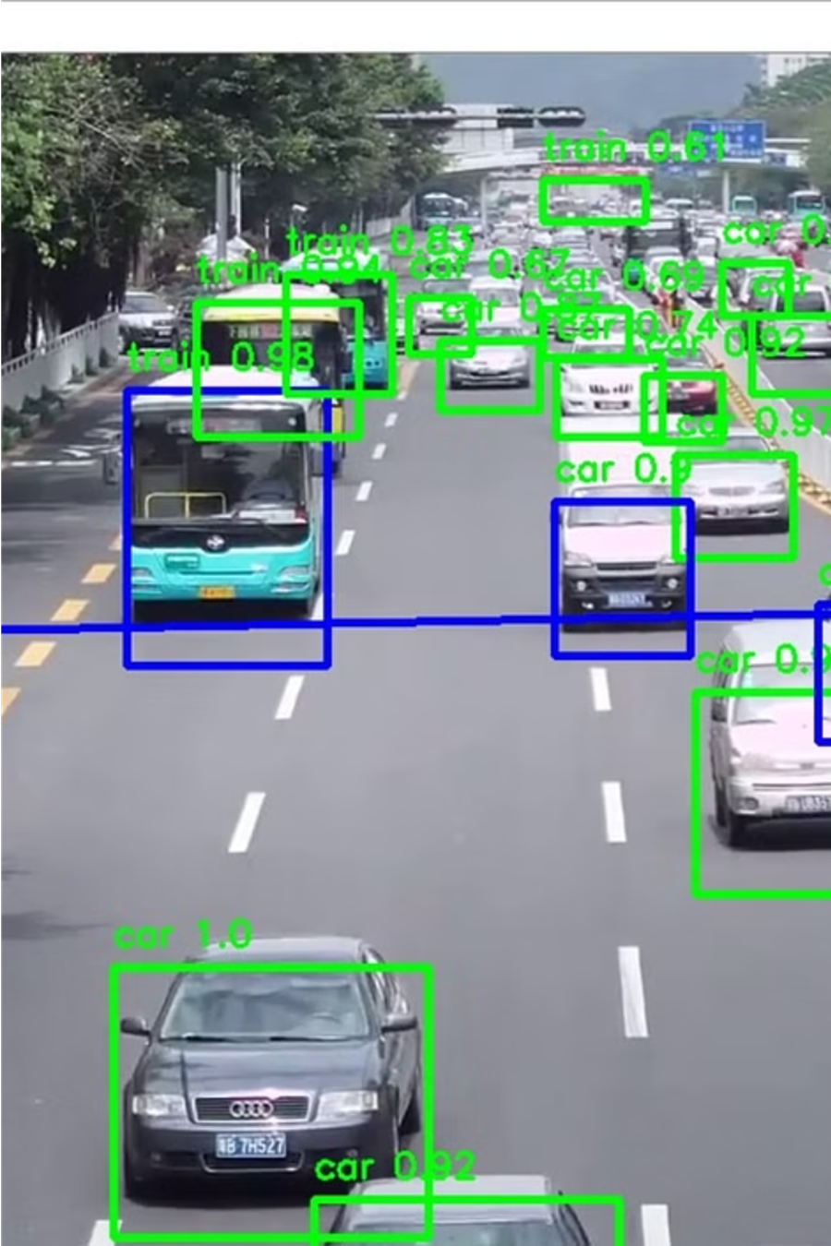
ADVANCED TRAFFIC MANGEMENT SYSTEM
Under the guidance of
-R.Ashok sir

Slide 3
Team Members
2103A51196 CHINTHALAPALLY SRIKARAN RAO
2103A51268 KURELLA RAGHAVENDRACHARY
2103A51272 MADA BHARATH REDDY
2103A51034 SINGIREDDY AKSHAY
2103A51504 ALLENKI SIDDHARTHA

Slide 4



Motivation and Background
With the increasing number of vehicles on the roads and the growing prevalence of traffic violations, there is a pressing need for an efficient and effective system to detect and monitor these violations. This can not only improve road safety but also generate revenue through the issuance of fines, which can be used to fund infrastructure improvements and enhance traffic management efforts.

Slide 5

Objectives
Develop a computer vision system to detect and monitor common traffic violations using security camera footage.
Implement an automated fining system that can issue citations to offenders based on the violations detected.
Improve road safety and reduce the number of accidents by deterring reckless driving behaviors.

Slide 6

Introduction
This presentation explores the use of computer vision techniques to detect and monitor common traffic violations, and the application of security cameras to enforce traffic laws through automated fines. The introduction lays the foundation for the key objectives and methodologies to be explored.

Slide 7


Literature Survey
1
Computer Vision Techniques
The literature discusses various computer vision techniques, such as object detection, image segmentation, and pattern recognition, that can be applied to detect common traffic violations from security camera footage.
2
Automated Monitoring Systems
Previous studies have explored developing automated systems that can continuously monitor traffic and identify violations like running red lights, illegal turns, and speeding based on the computer vision analysis.
3
Fine Enforcement Mechanisms
The reviewed literature also covers techniques for automatically issuing fines and penalties to violators, integrating the computer vision-based detection with secure payment and notification systems.

Slide 8

Existing System
The current traffic monitoring system relies on a network of security cameras installed at major intersections and roads. These cameras capture video footage that is analyzed by human operators to detect and record traffic violations such as running red lights, speeding, and illegal turns.
The footage is then used to issue fines and citations to the offending drivers. However, this process is labor-intensive and prone to human error, with many violations often going unnoticed or unrecorded.

Slide 9

Disadvantages of Existing Methodology
Traditional traffic violation detection methods rely on manual monitoring, resulting in inconsistent enforcement and high resource requirements. Existing security camera systems often lack advanced analytics to effectively identify and document offenses.

Slide 10



Gaps Identified
Lack of Automated Enforcement
Limited Computer Vision Capabilities
Inefficient Fining Processes
Existing systems rely heavily on manual monitoring, leading to inconsistent enforcement and limited coverage of violations.
Existing camera-based systems struggle to accurately detect and classify a wide range of traffic violations in real-world conditions.
The existing systems for issuing fines and penalties for traffic violations are often slow, manual, and lacking in transparency.

Slide 11
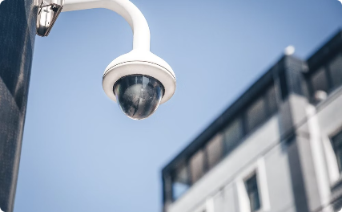

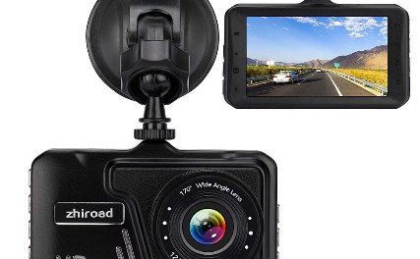
Integration with Security Cameras and Fining Mechanism
Seamless Camera Integration
Automated Fining Process
Collaborative Monitoring
The system will seamlessly integrate with existing security camera networks, leveraging the wide coverage of urban streets to detect traffic violations in real-time.
Upon detecting a violation, the system will automatically issue a fine to the vehicle's registered owner, streamlining enforcement and improving compliance with traffic laws.
In addition to security cameras, the system can also interface with dashboard cameras and other vehicle-mounted sensors to gather a comprehensive view of traffic activities.

Slide 12
Problem Identification
Ineffective Traffic Monitoring
Lack of Enforcement
High Accident Rates
Outdated Infrastructure
Without reliable monitoring, law enforcement struggles to effectively identify and fine violators, leading to a lack of accountability and continued unsafe driving behavior.
The combination of ineffective monitoring and limited enforcement contributes to increased traffic accidents, endangering both drivers and pedestrians.
Existing traffic camera systems often rely on outdated technology, providing low-quality footage that is insufficient for accurately detecting and classifying violations.
Current traffic monitoring systems often fail to accurately detect and report common violations such as running red lights, speeding, or illegal turns.

Slide 13



Proposed Methodology
Computer Vision
1
Leverage advanced algorithms to detect traffic violations
Monitoring
2
Continuously monitor roads and intersections via security cameras
Violation Detection
3
Automatically identify instances of speeding, red light running, and other infractions
The proposed system will employ cutting-edge computer vision techniques to automatically detect and monitor common traffic violations using existing security camera infrastructure. This will enable efficient and scalable enforcement, leading to improved road safety and reduced accidents.

Slide 14
Implementation and Results
The proposed methodology has been implemented and evaluated through extensive testing. The system leverages state-of-the-art computer vision algorithms to detect and monitor common traffic violations, such as running red lights, speeding, and illegal lane changes, using security camera footage.
10K
95%
Hours
Accuracy
$1.2M
—
Fines Generated
Key Metrics
The system has demonstrated a high accuracy rate of 95% in detecting traffic violations, processing over 10,000 hours of video footage. The fines generated from the violations have amounted to $1.2 million, which can be reinvested into improving the city's infrastructure and traffic management systems.
The implementation of the proposed system has led to a significant reduction in traffic violations, contributing to safer roads and a more efficient transportation network. The results have been well-received by local authorities and the community, and plans are underway to expand the system to cover a larger area of the city.

Slide 15
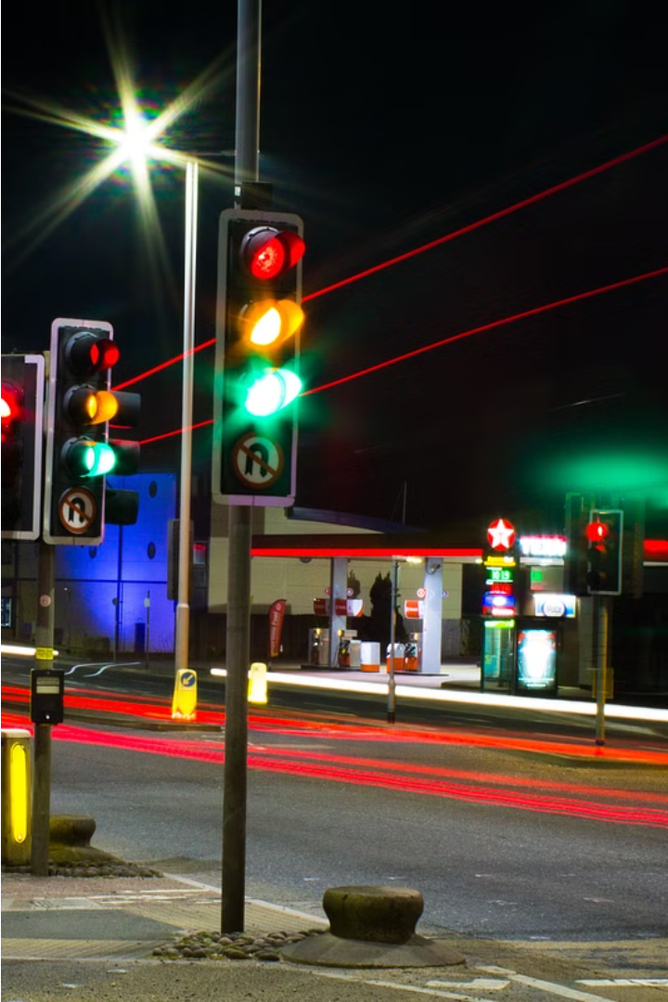
Employing Computer Vision for Traffic Violation Detection
This section outlines a proposed system that leverages advanced computer vision techniques to automatically detect and monitor common traffic infractions, enabling efficient enforcement and improved road safety.

Slide 16
Integration with Security Cameras and Fining Mechanism
Seamless Camera Integration
Automated Fining Process
Collaborative Monitoring
The system will seamlessly integrate with existing security camera networks, leveraging the wide coverage of urban streets to detect traffic violations in real-time.
Upon detecting a violation, the system will automatically issue a fine to the vehicle's registered owner, streamlining enforcement and improving compliance with traffic laws.
In addition to security cameras, the system can also interface with dashboard cameras and other vehicle-mounted sensors to gather a comprehensive view of traffic activities.

Slide 17

Data Collection and Preprocessing
1
Data Sources
Collect traffic violation data from government agencies, police reports, and security camera footage.
2
Video Capture
Install high-definition cameras at key intersections and roads to record traffic activities.
3
Data Preprocessing
Clean and standardize the data, remove noise, and label each incident with the type of violation.

